Slide 1
SECURE DATA HIDING IN IMAGES USING STEGANOGRAPHY
SECURE THE DATA TO PREVENT HACKERS
Presented By:
Student Name : NIHIL H
College Name & Department : Department Of Computer Science & Engineering /Dhanalakshmi Srinivasan College Of Engineering

Slide 2
OUTLINE
Problem Statement
Technology used
Wow factor
End users
Result
Conclusion
Git-hub Link
Future scope

Slide 3
Problem Statement
Create a Python program that can encrypt and decrypt a secret message by embedding the message into an image using steganography. The message will be hidden in the least significant bits (LSBs) of the image pixels. This will allow the image to appear unchanged to the human eye while secretly containing the encrypted message.

Slide 4
Technology used
VSCode is used to implement the code.
The code is written in Python.
The opencv library is used for image processing.

Slide 5
Wow factors
Image Processing & Manipulation
Message Encryption
Message Extraction & Decryption
Handling Binary Data
Practical Use of Cryptography
Hands-on experience in image processing, cryptography, and data hiding techniques
Implement basic encryption algorithms, Steganography methods and combine both to create a secure message transmission method

Slide 6
End users
Security Professionals / Cybersecurity Experts
Government and Intelligence Agencies
Private Individuals Concerned with Privacy
Organizations with Sensitive Data
Cryptography Enthusiasts and Hobbyists

Slide 7
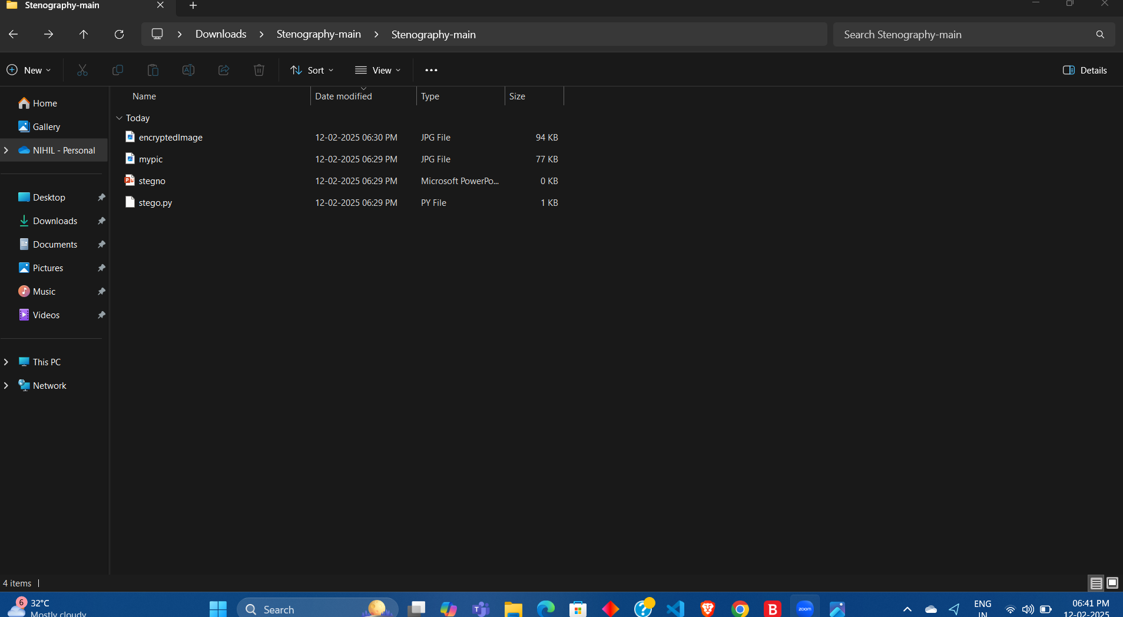
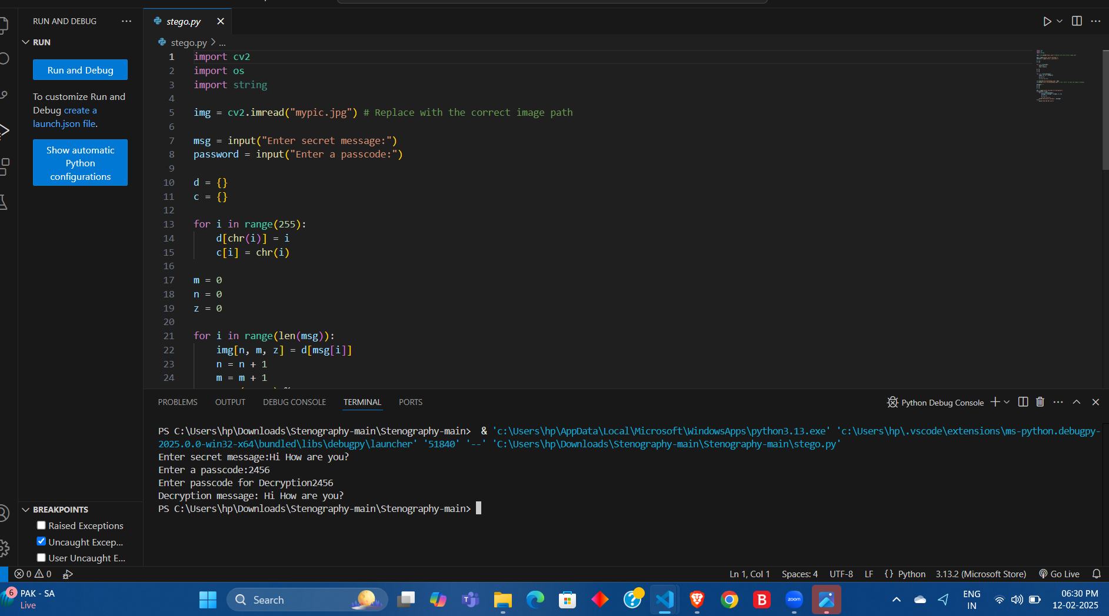
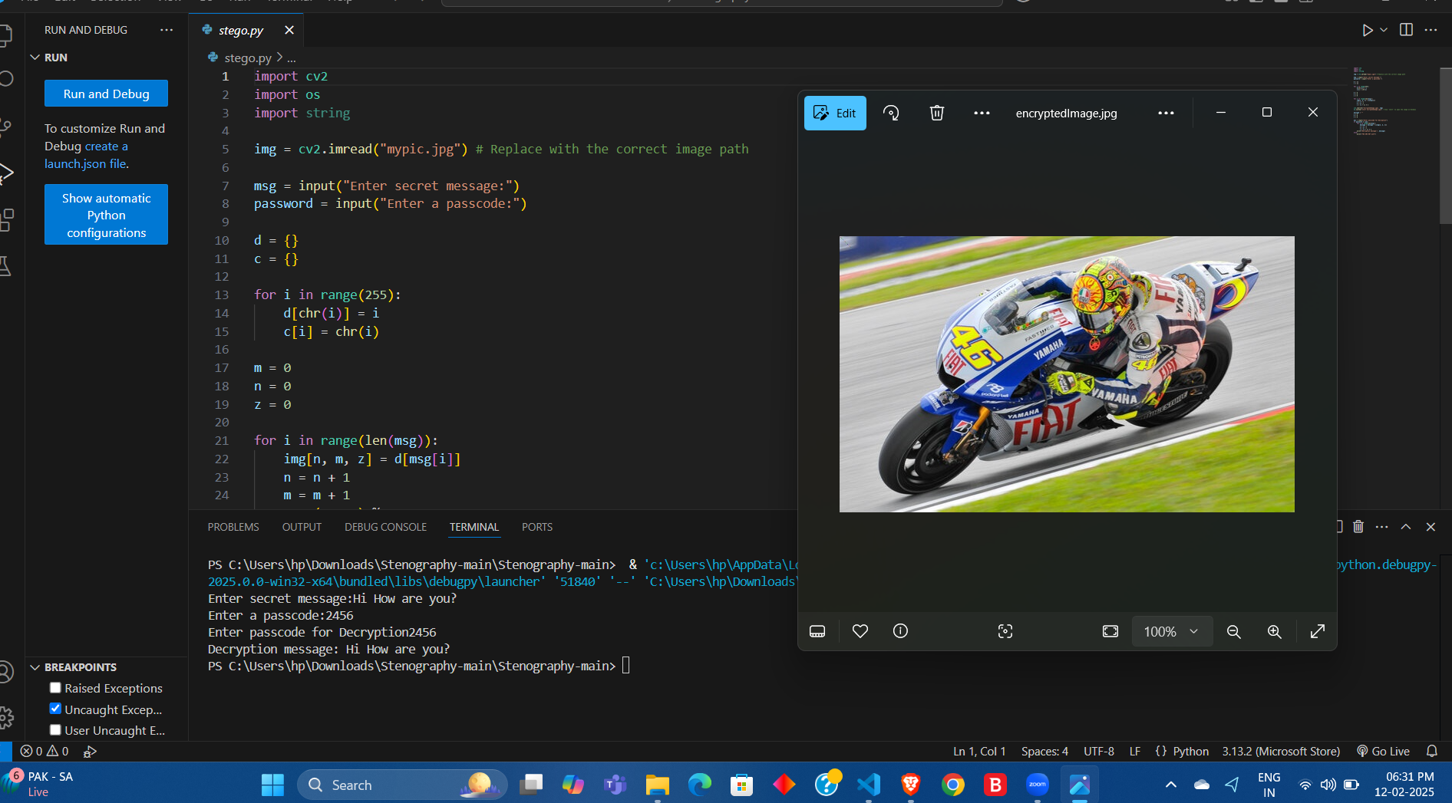
Results
Screenshots of the outcome (min 3)

Slide 8
Conclusion
The Steganography-based Encryption and Decryption Project effectively demonstrates how cryptography and steganography can be integrated to create a robust method of secure communication. By embedding an encrypted message within an image, this project ensures that confidential information is hidden in plain sight, offering a dual layer of protection—encryption to secure the message and steganography to hide it.
In conclusion, this project highlights the power of combining encryption and steganography for enhanced security and privacy, ensuring that sensitive data remains hidden and protected from unauthorized access.

Slide 9
GitHub Link
https://github.com/nihil-h/MY-Project.AICTE.git

Slide 10
Future scope(optional)
Integration of Advanced Encryption Techniques
Expanding to Other Media Types : Audio Steganography , Video Steganography
& Text Steganography

Slide 11
THANK YOU

